Slide 1
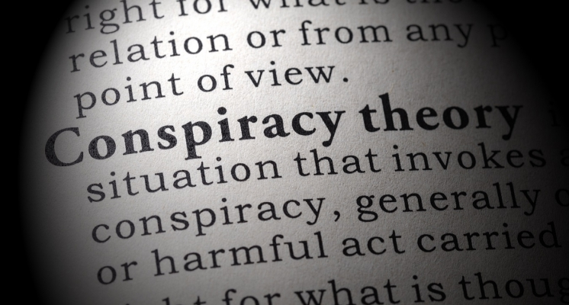
The United Stories of Conspiracy
On the networks and influencers of untruths
Hannah Ho, Hannah Warren, David Owen, Akankshi Mody, Candice Zuo, Ananya Garg
Notes:
Who controls the spread of information? Is it a few key individuals, or more democratic? We set to find these answers out by studying the activity surrounding conspiracy theories on Twitter.
Team BirdsAren’tReal
Presetnting on the networks of conspiracy theories in the united states
My name is hannha...this is….

Slide 2

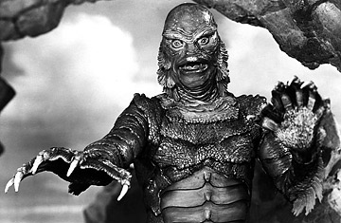
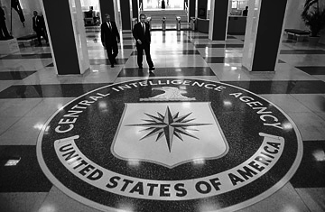
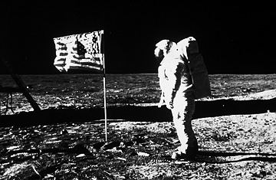
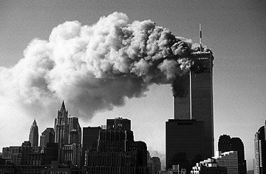
Reptilian Elite
CIA and AIDS
Conspiracy theories
Chemtrails
Iowa Caucus
Deep State
Flat Earth
Fake Moon Landings
9/11 Cover Up
Notes:
Hannah Ho
Many conspiracy theories obvious, such as
Rep: the wordl is ruled by an undergroun group of repitles
Cia spread aids, we know is likely not true bc they have no incentive to do so
That the moon landings were fake or that 9-11 never happened
Howevr inobvious conspiracy : more ppl believe to be true, such as…..which we’ll go into more details about

Slide 3
Why Understand Conspiracy Theory Networks?
Understand how misinformation spreads
Increased skepticism in the government
Potentially harm lives
Sources:
https://www.psychologytoday.com/us/blog/social-dilemmas/201508/the-surprising-power-conspiracy-theories
https://www.nytimes.com/roomfordebate/2015/01/04/are-conspiracy-theories-all-bad-17/the-negative-social-impact-of-conspiracy-theories
Notes:
Hannah Ho
It’s important to underst ctn’s for a few reasons
As academics we pursuet he trutth, and alongside that it’s important to understand the nature of non-truths
Conspiracies can potentially harm lives, for example, the antivaccincation conspiracy was started by a paper claiing that vaccines caused autism. Even though the authoer later retracted the paper and it was disproven by many other resaerchers, it’s led many parents to not vaccinate their children, which puts their own children and others at risk for disease.
Decreased trust in govt can be very destabilizing for society
Potentially harm lives: can give rise to dangerous and unscientific movements like the anti-vaxxx
Conspiracies spiral: It is never just one conspiracy, people tend to believe both climate change is a hoax and 9/11 was an inside job over just one because of their susceptibility
Potential impact on quality of life?
anecdote/research
Academic pursue truth
Sources: NYTimes a nd Psychology today
So you can stop them

Slide 4
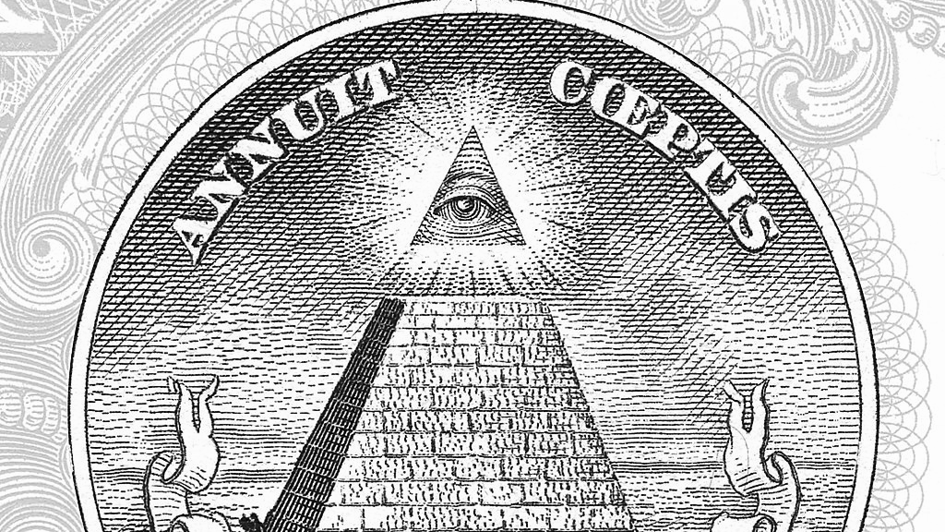
How Conspiracy Theories Spread
Influencer driven vs self sustaining
Resistance vs acceptance to facts
How different types of conspiracies propagate
Can they be stopped?
Notes:
Ananya

Slide 5
How did we track our Conspiracy Theories?
FInd the hashtags most commonly used with a conspiracy theory
Typically contradictors use the same hashtag with words like conspiracy suffixed to it
Find those conspiracy theories that have a good amount of tweets to be able to put a graph together
Notes:
Ananya

Slide 6
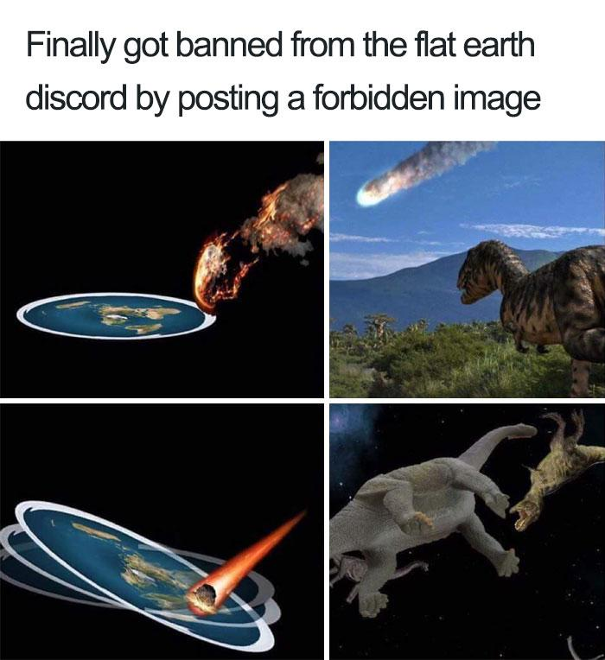
Notes:
Hannah W.

Slide 7
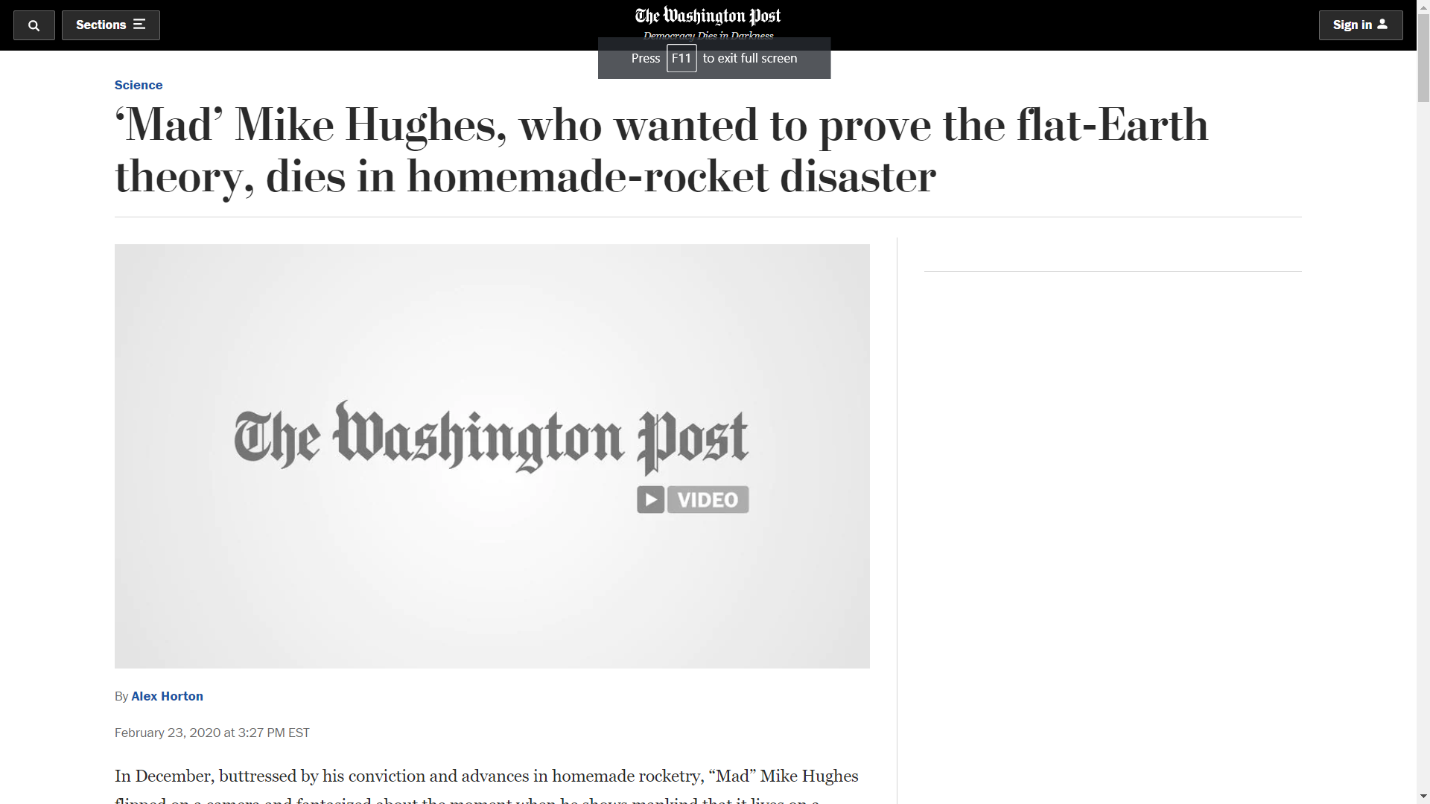
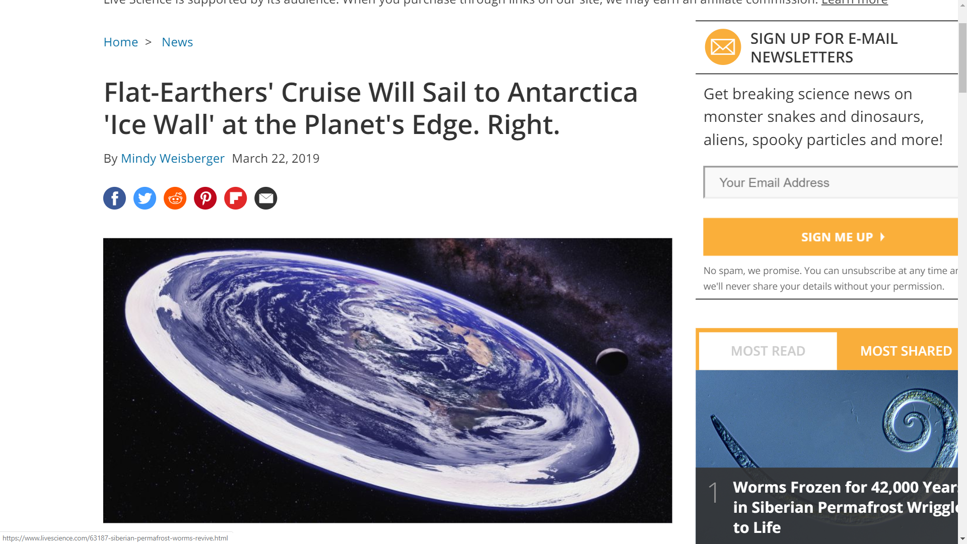
Notes:
Hannah W

Slide 8
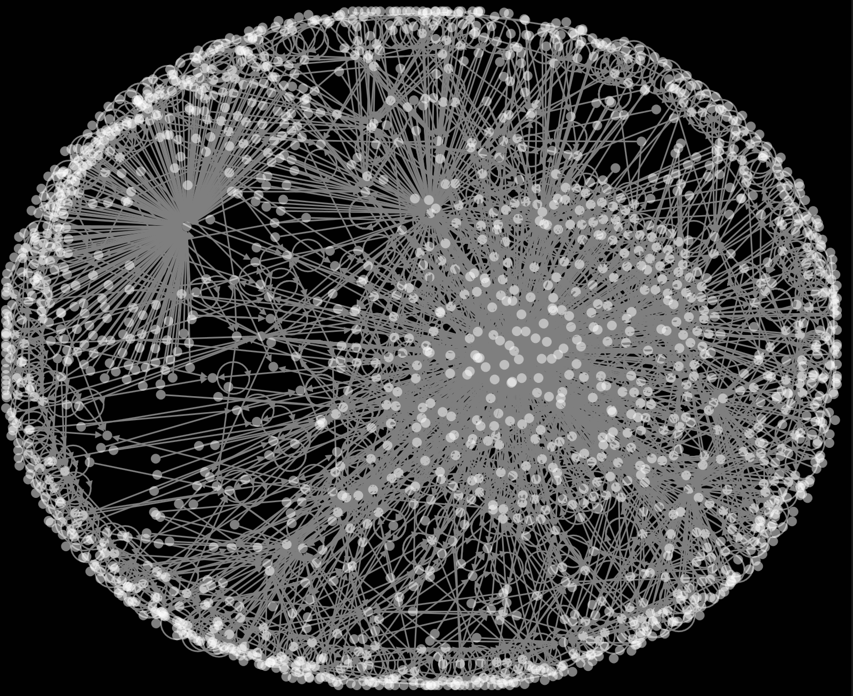
Flat Earth
Notes:
Tweet and retweet graph
Hannah W

Slide 9
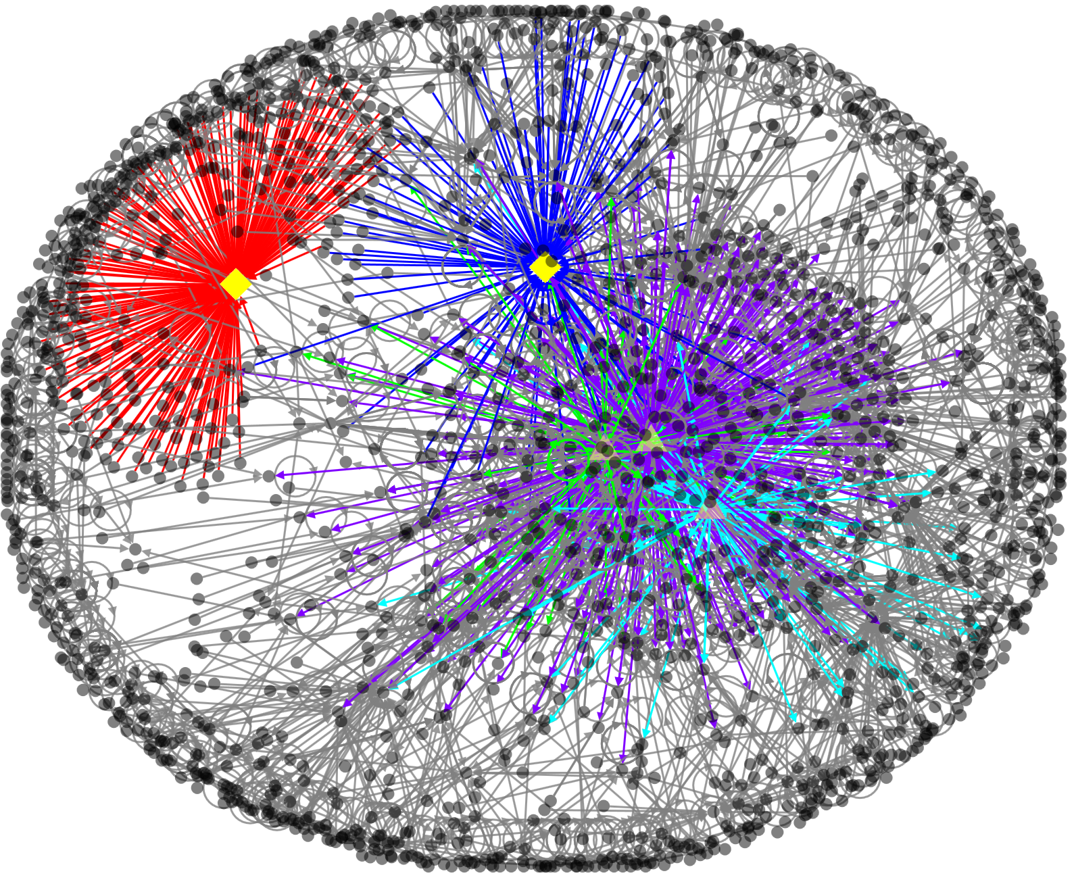
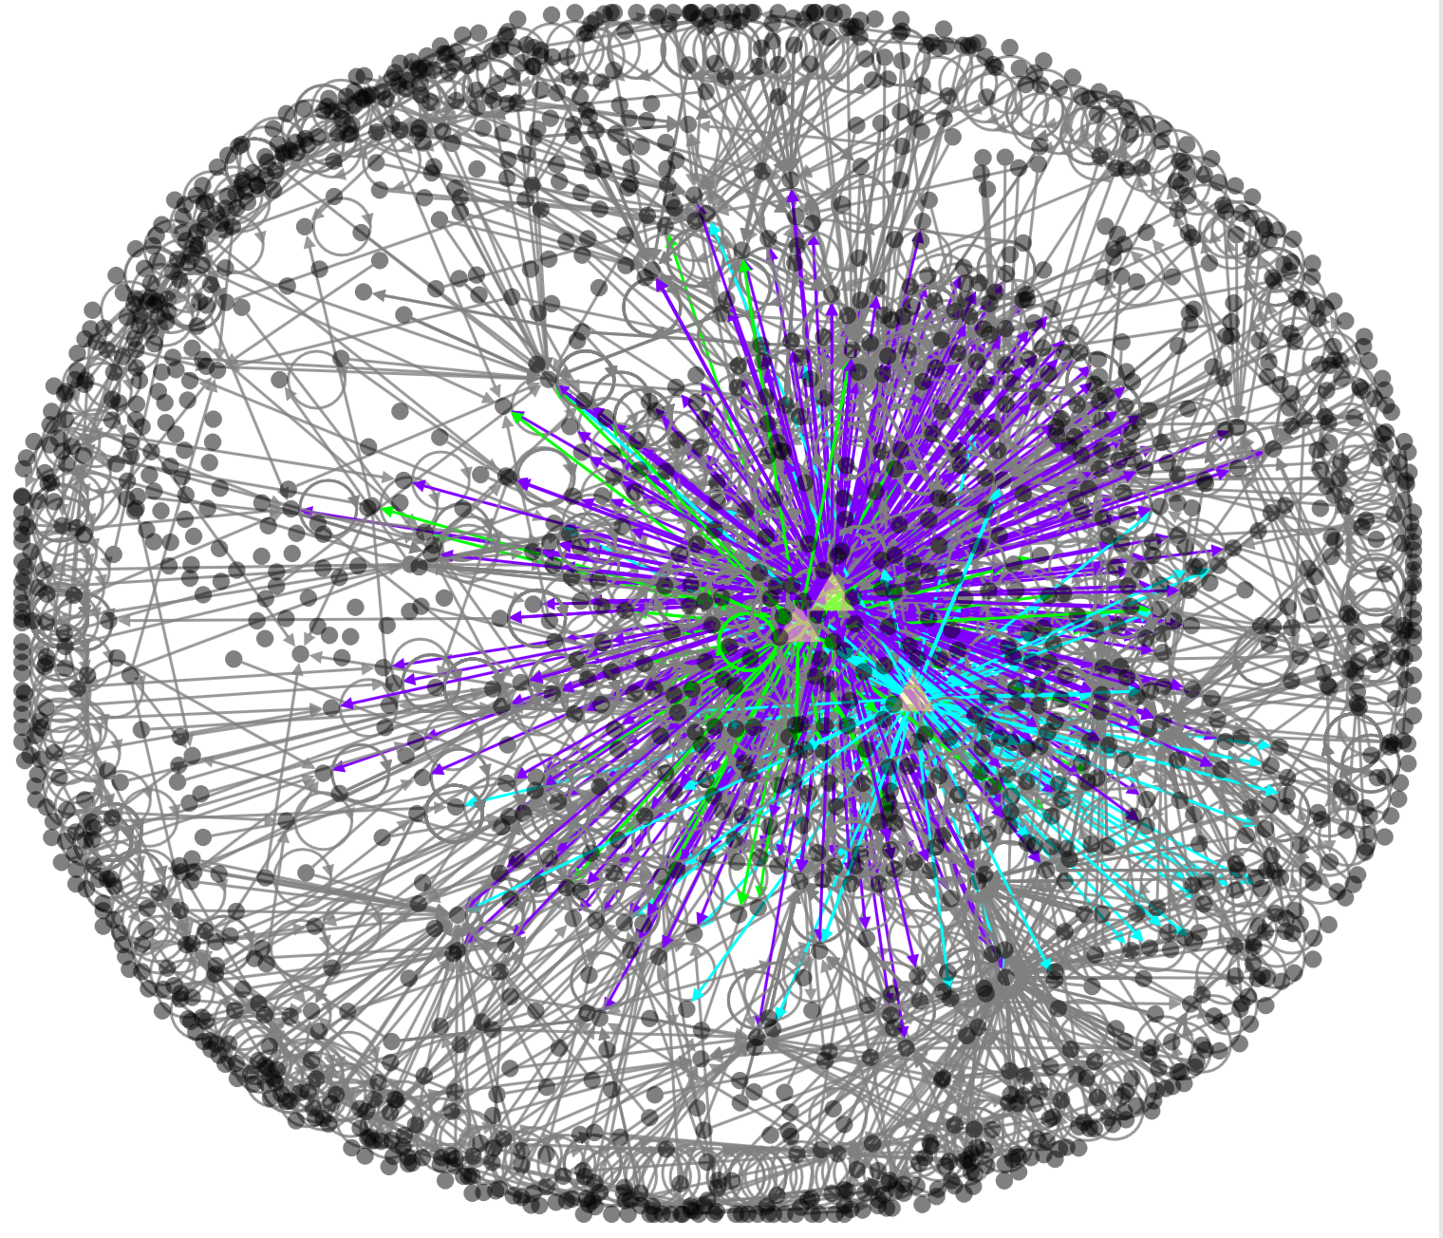
Flat Earth
Notes:
Get main influencers’ twitter handles
Hannah W
Graph on the right: red and blue == max degree → influencers
Removing them results in 3 key nodes, those are actually bots
Makes the network self-sustaining
Red → user _youhadonejob1 (meme/joke/parody account)

Slide 10
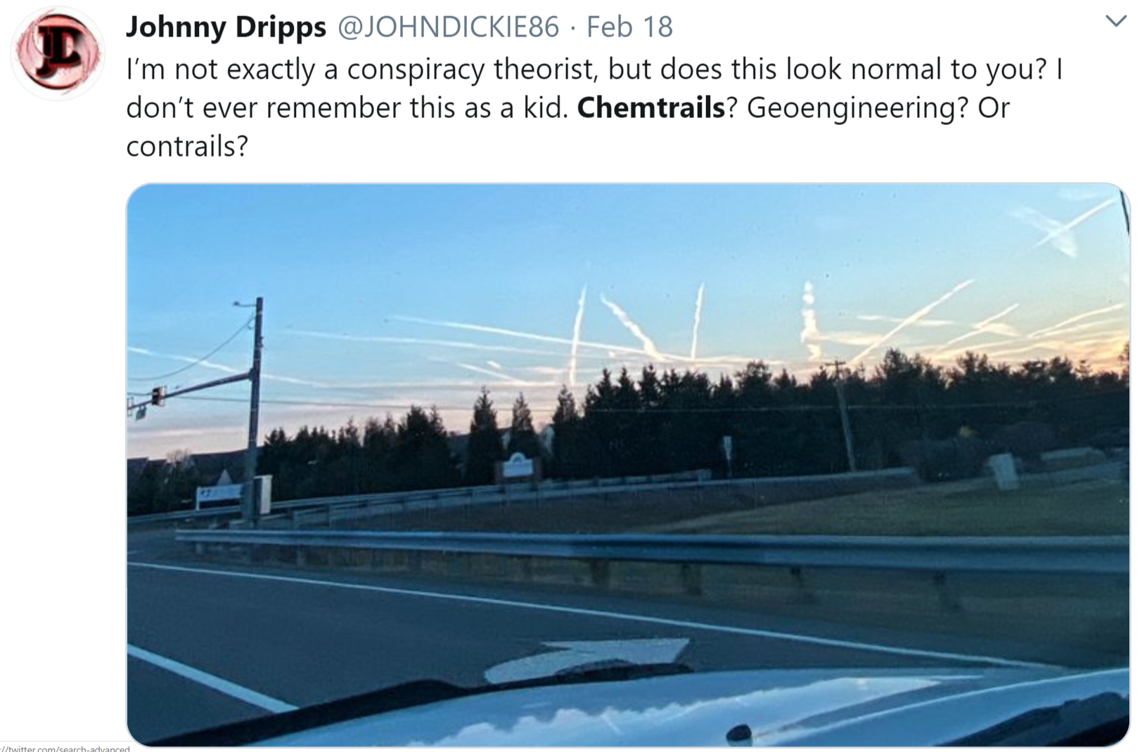
What is the Chemtrails conspiracy?
Notes:
Akankshi

Slide 11
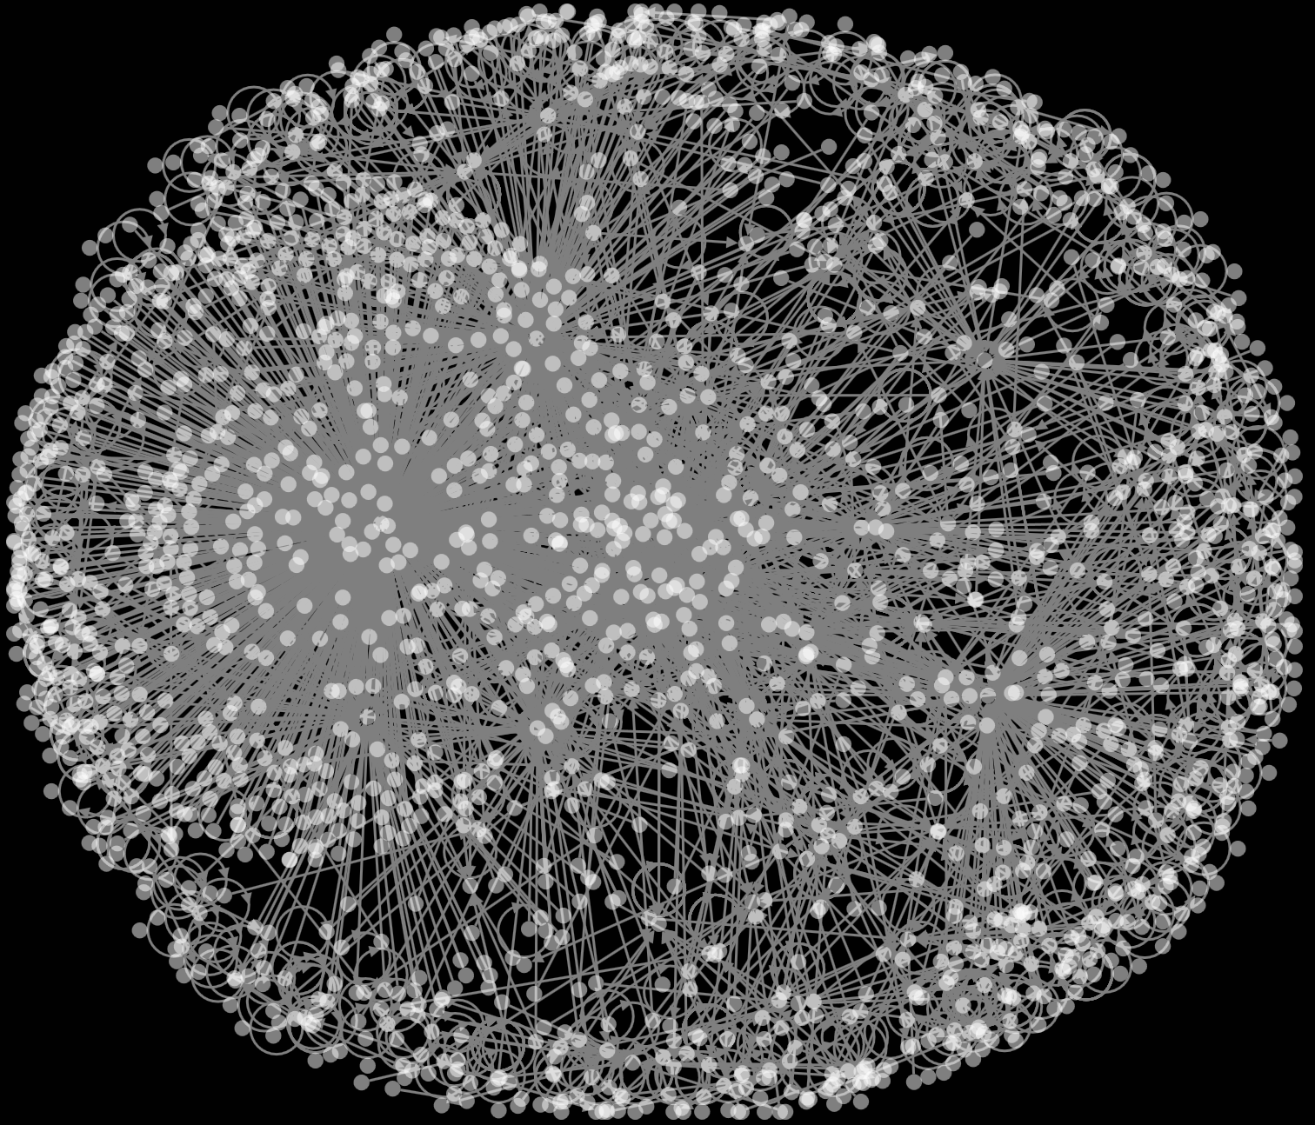
Chemtrails
Notes:
Tweet and retweet graph
Hannah W

Slide 12
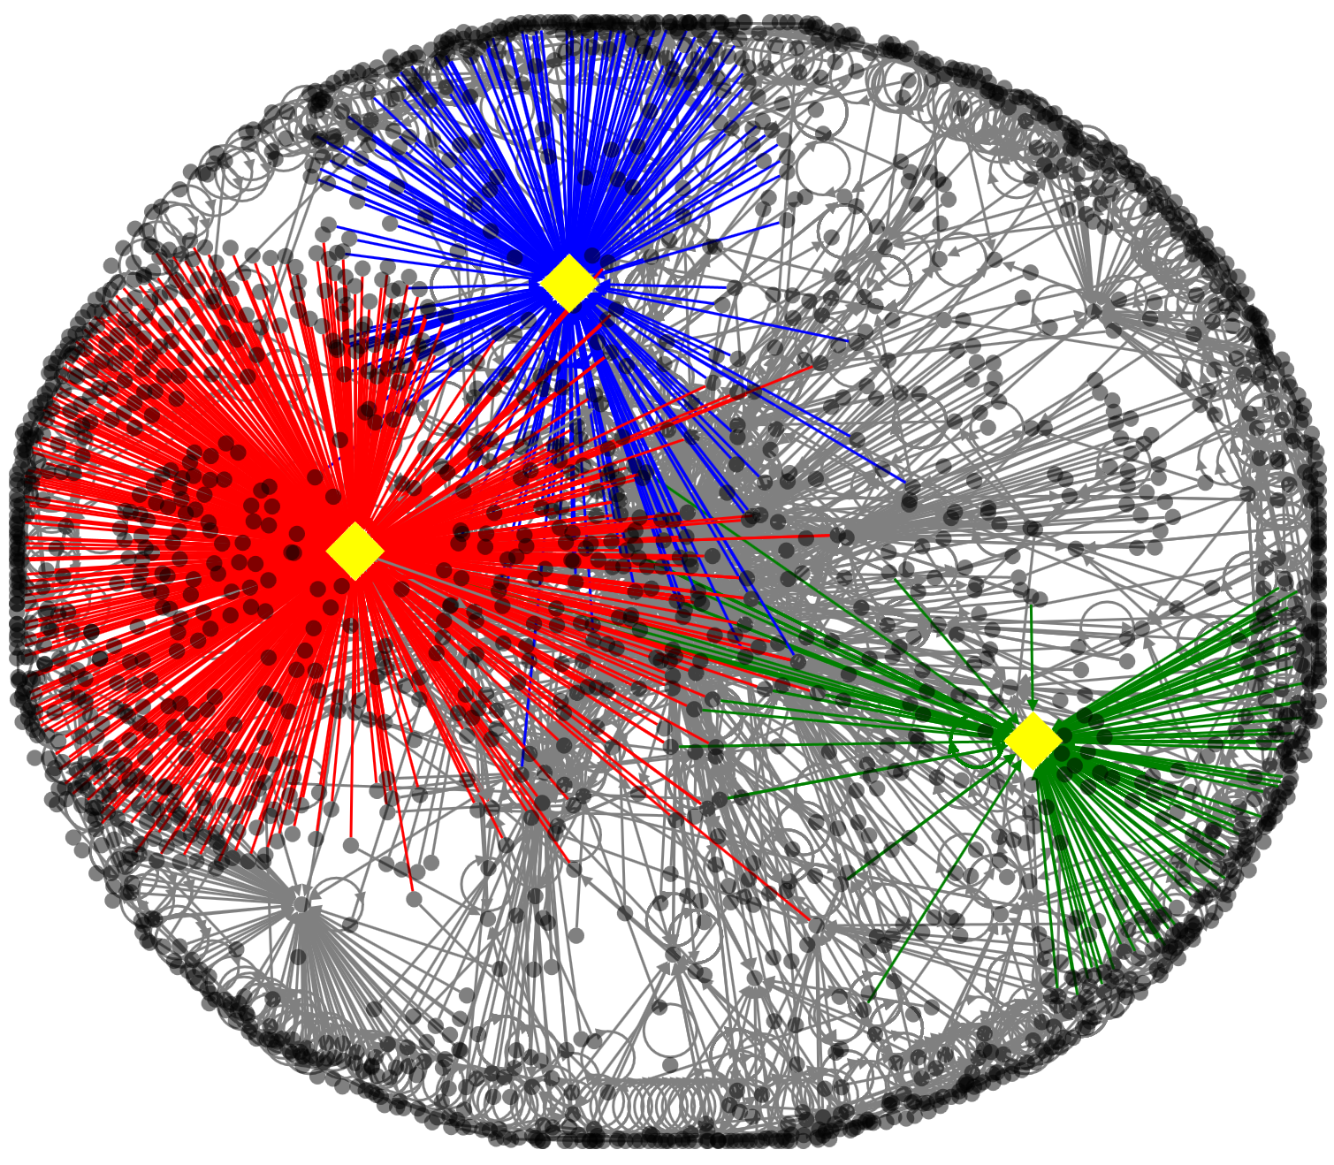
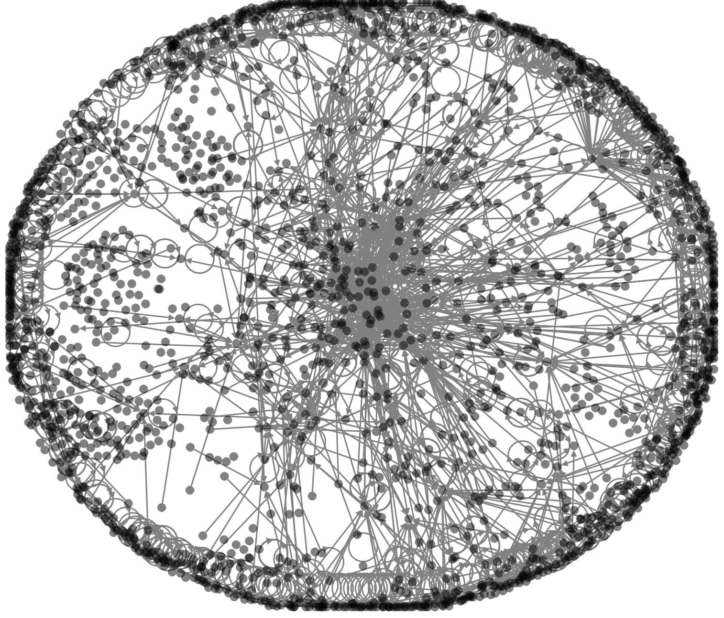
Chemtrails
Notes:
One sided
Get color coded version and twitter handles of top influencers
Akankshi

Slide 13
Fact vs. Fiction:
Two Sides of a Conspiracy
Notes:
Here we talk about conspiracy theories that face opposition

Slide 14
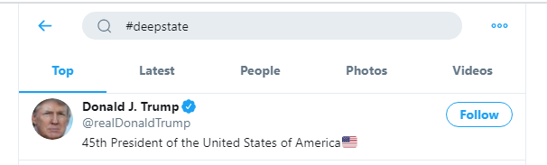
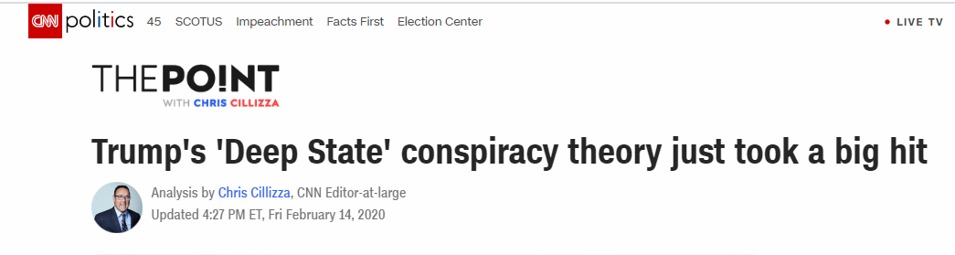
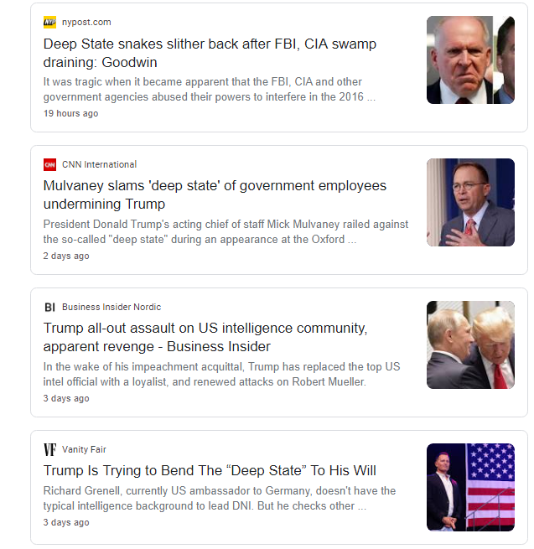
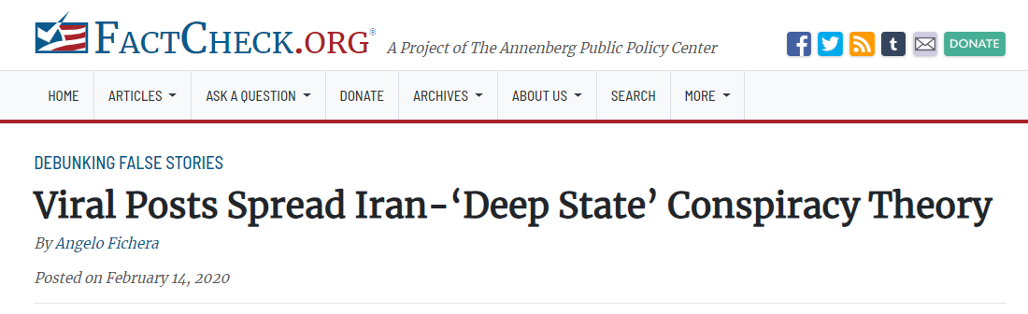
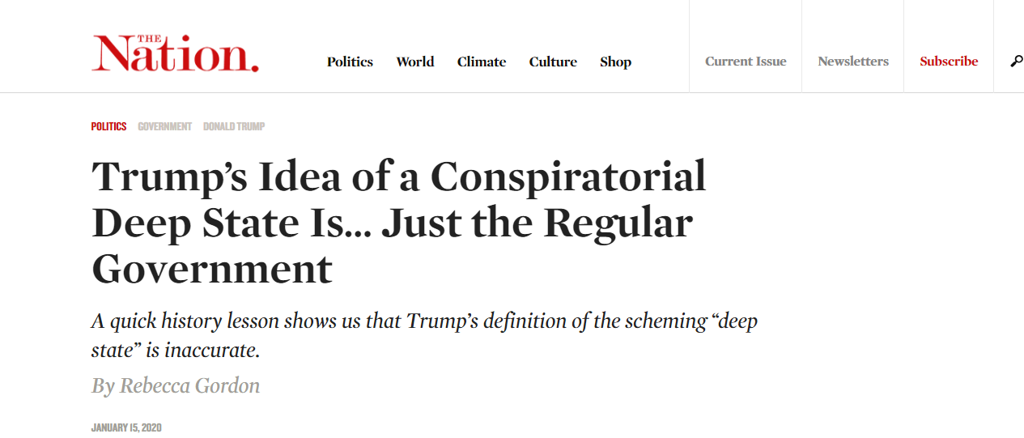
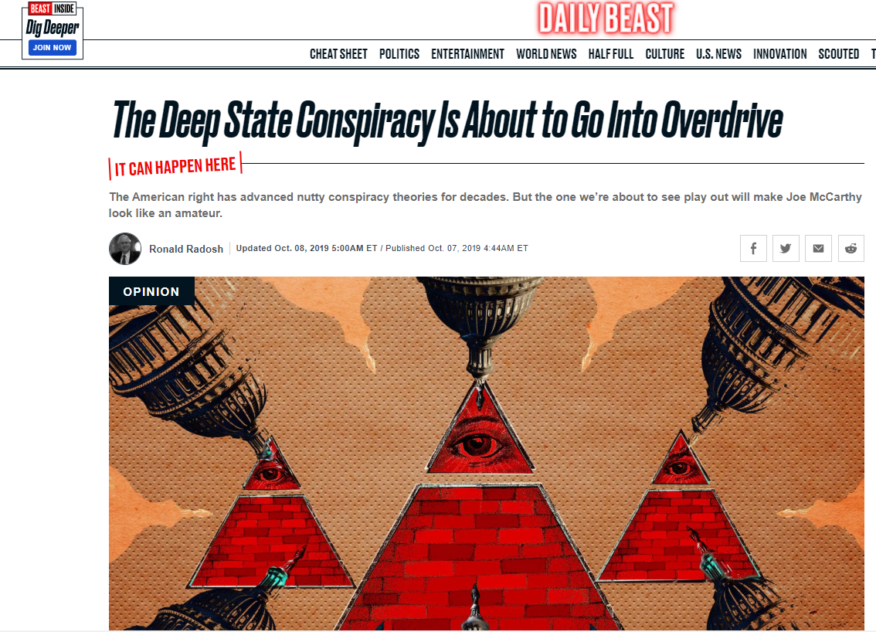
What is the Deep State conspiracy?

Slide 15
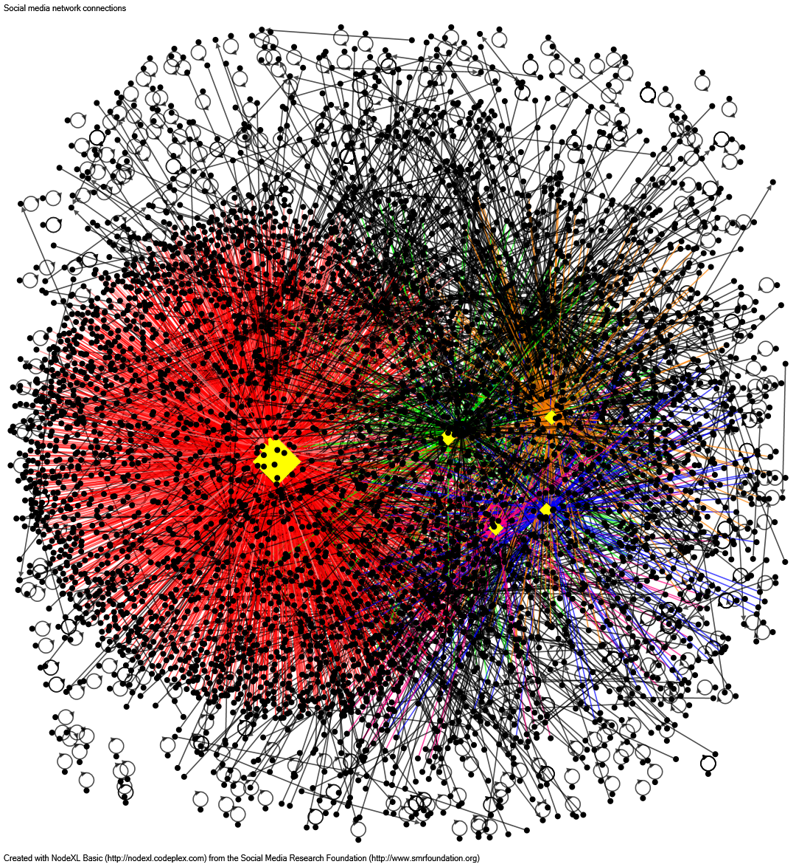
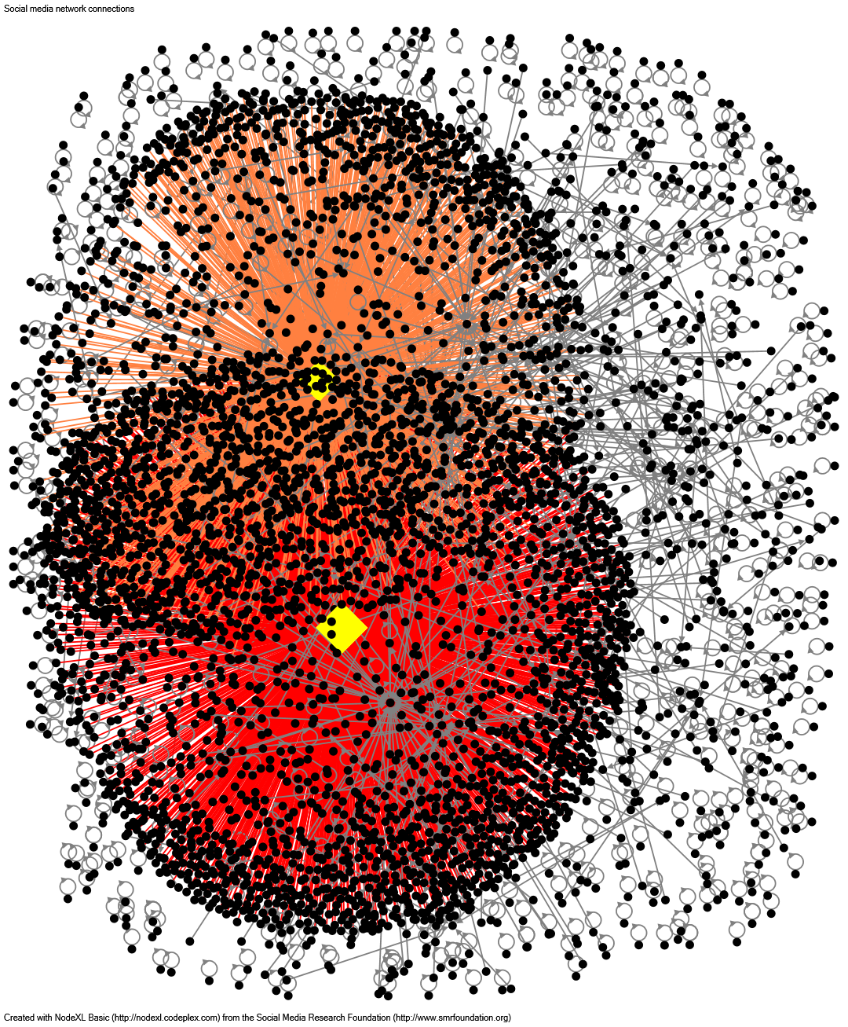
The Deep State
#DeepState
“Deep state conspiracy”
Notes:
Hastag users people are the conspiracy theorists
Opposing side uses the word ‘conspiracy’

Slide 16
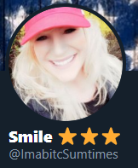
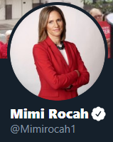
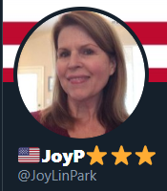
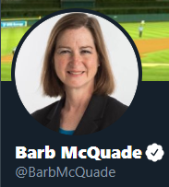
The Deep State
#DeepState
“Deep state conspiracy”
Notes:
Top influencers identified.
Smile is Russian Bot
JoyP is Russian Bot
Barb: @UMichLaw prof; legal analyst @NBCNews, @MSNBC
Mimi: Former Fed Prosecutor SDNY; Pace Law School Prof.

Slide 17
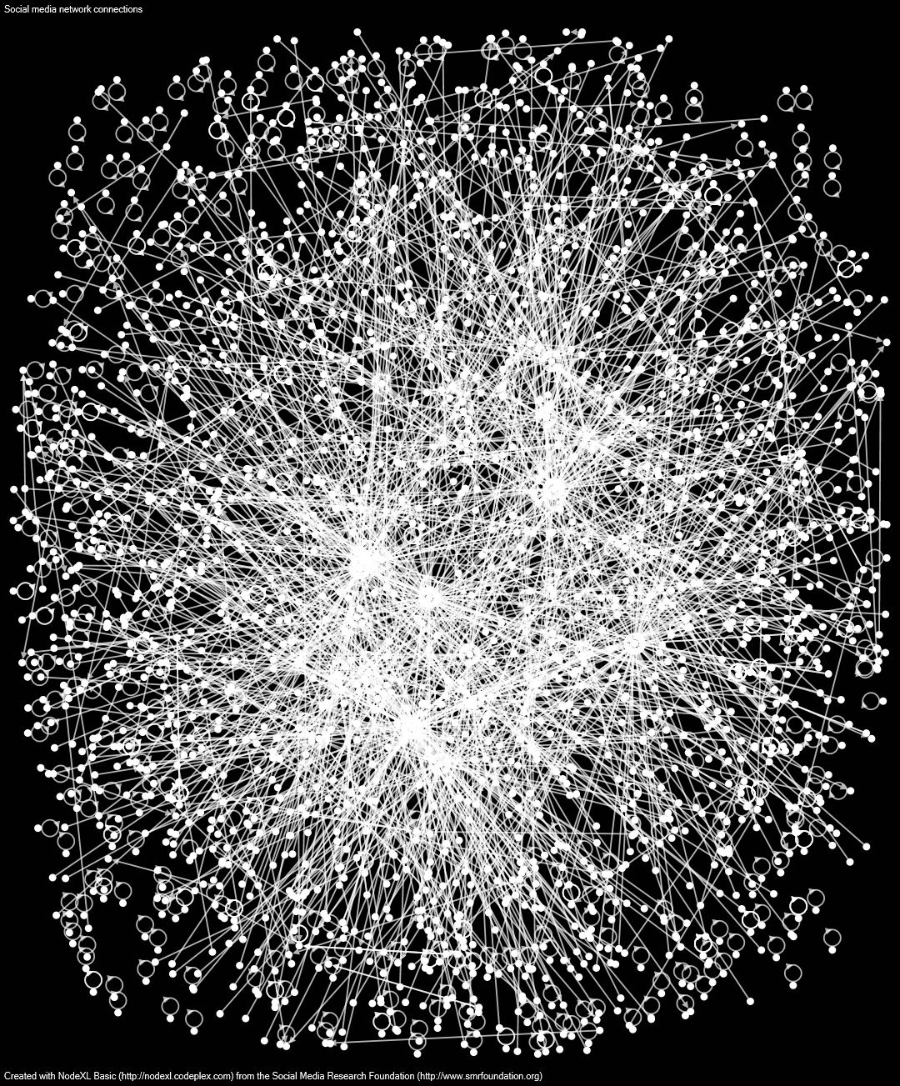
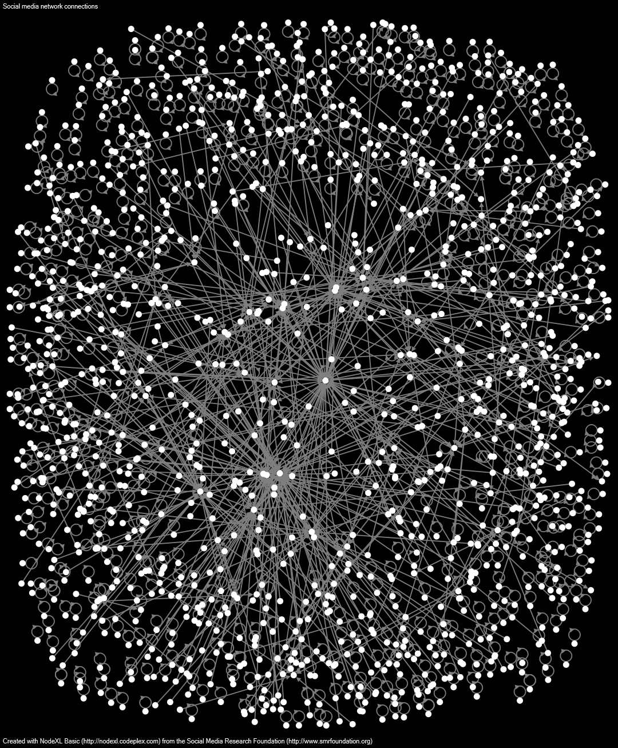
The Deep State
#DeepState
“Deep state conspiracy”
Notes:
Deep state: top 10 removed; still lots of activity; this is bad! The conversation is self-sustaining
Deep state conspiracy: only top 2 removed and the network is already falling apart; people aren’t as aggressively trying to disprove the conspiracy

Slide 18
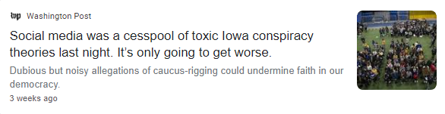
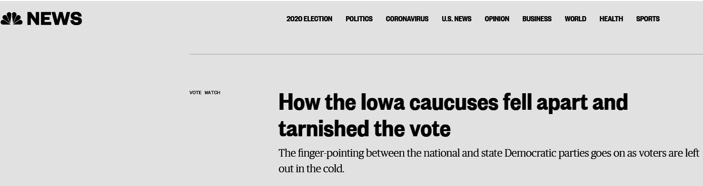
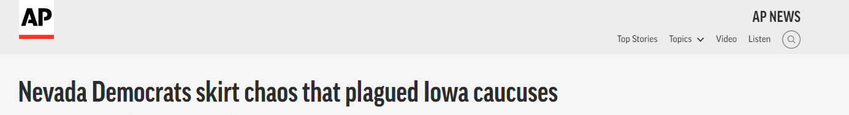
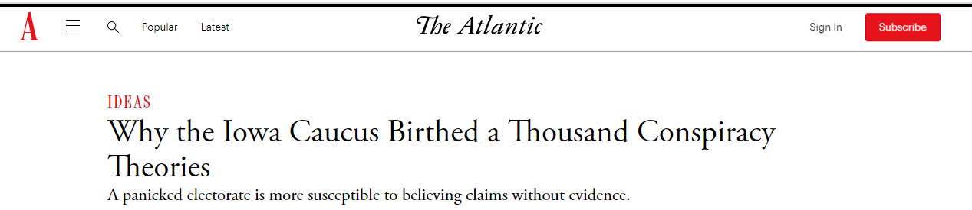
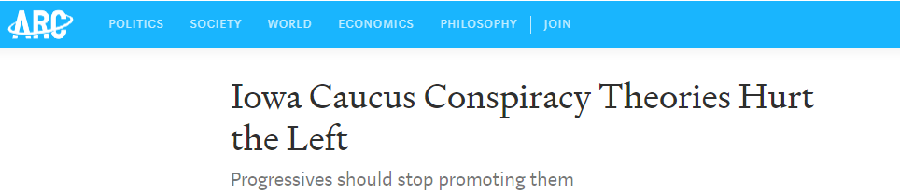
What is the Iowa Caucus conspiracy?
Notes:
This data was scraped one week after the results of the caucus were finalized

Slide 19
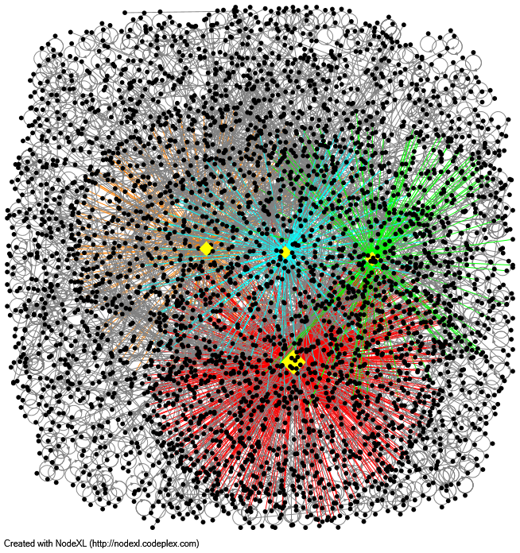
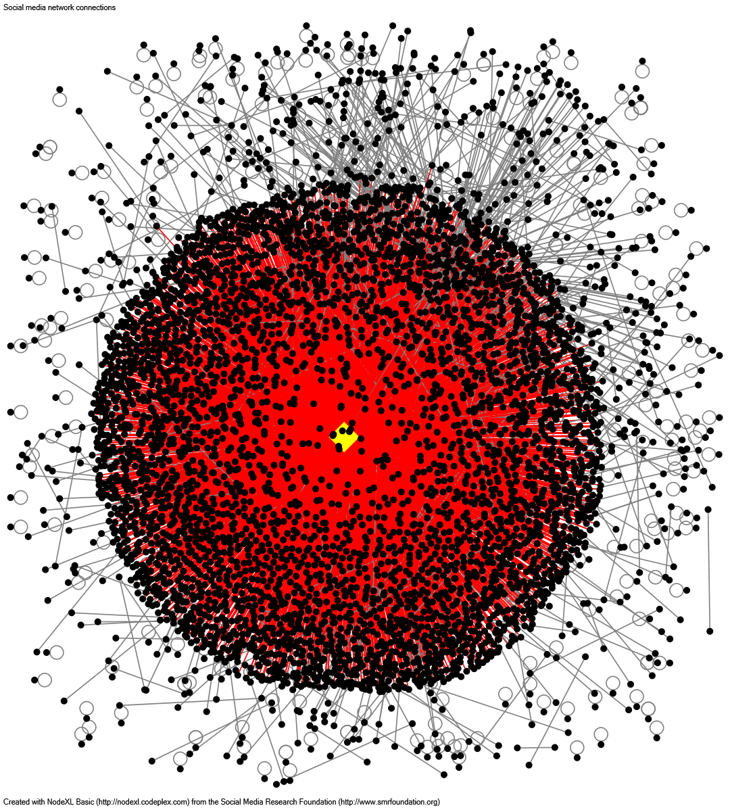
The Iowa Caucus
#DNCRigged
#IowaCaucus

Slide 20
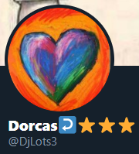
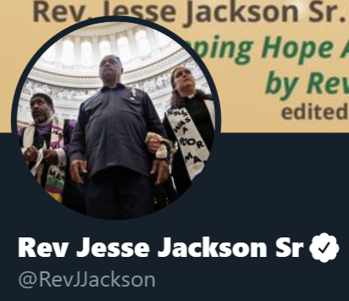
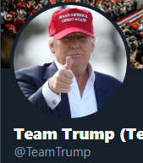
The Iowa Caucus
#DNCRigged
#IowaCaucus
Notes:
Dorcas: a bot just like what we saw in the deep state
Team trump: not a bot, but makes sense to see Trump’s campaign account in there
Notice that this activity is mostly dominated by Jesse Jackson’s viral tweet
Jesse Jackson is a well known civil-rights activist

Slide 21
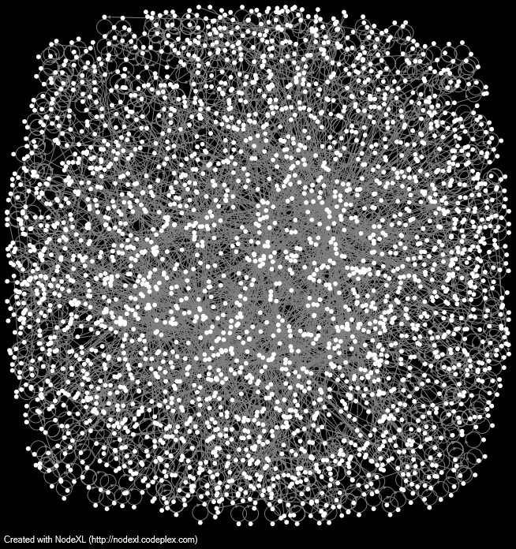
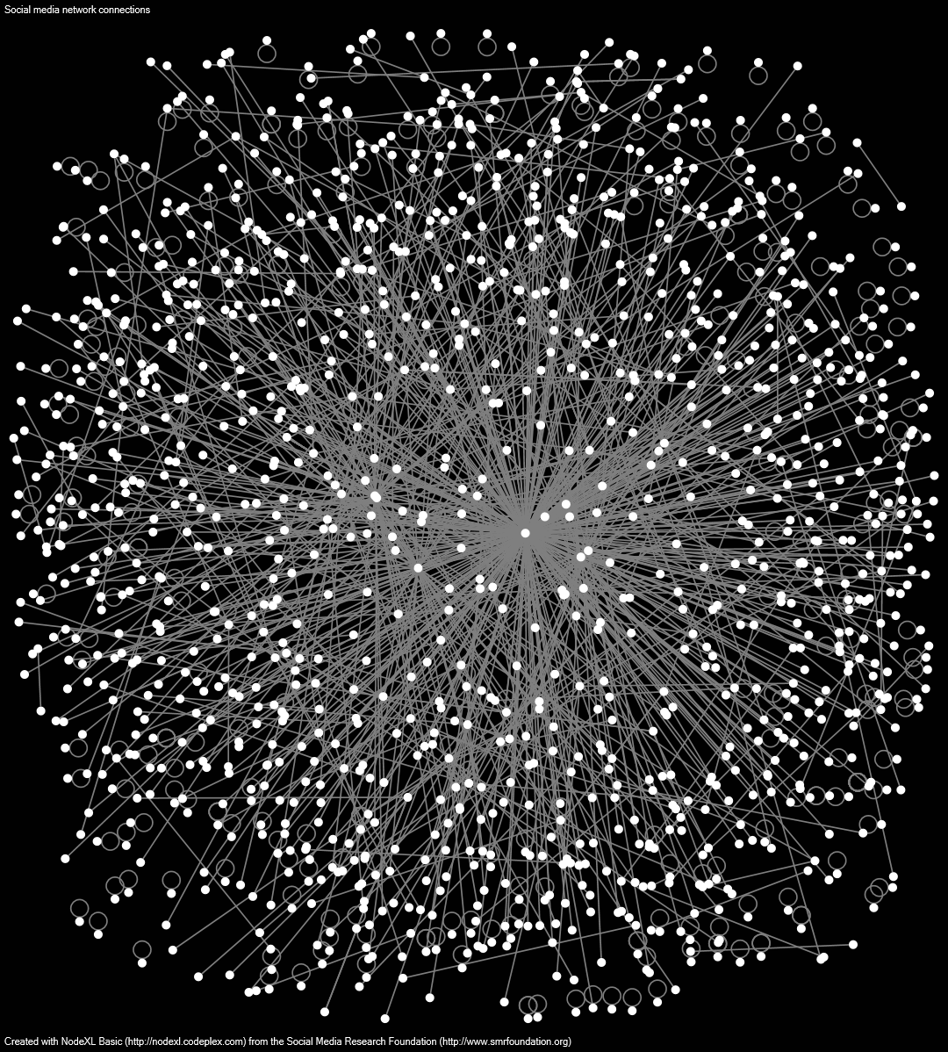
The Iowa Caucus
#DNCRigged
#IowaCaucus
Notes:
Central nodes removed?
DNC rigged: top 4 removed; the network is still very populated; this is bad!
Iowa Caucus: top 1 removed (Jesse Jackson’s tweet); the network is still fairly connected, but not to the same level as the first

